Slide 1



Sentiment analysis of web data to predict price fluctuation of cryptocurrencies
Group 4:
Jainam Jhaveri
Neha Sharma
Rushabh Vakharia
Sumesh Vijayan

Slide 2
Overview:
As the world’s first completely decentralized digital payment system, Bitcoin represents a revolutionary phenomenon in financial markets.
Following the path of Bitcoin, other cryptocurrencies like Litecoin and Ethereum also gave customers the option to divulge in the digital currency market.
Though existing only in digital form, the rise of these currencies is unstoppable.
Amidst this entire hype, there is growing concern focused on cryptocurrencies’ considerable price volatility and associated risks.
There exists a significant impact of social media on future cryptocurrency returns.
The web offers substantial information about bitcoin’s acceptance among the general public, as well as daily fluctuations in its market sentiments.
This helps investors gain insights into cryptocurrencies’ value from this information-rich environment.

Slide 3
Motivation:
The cryptocurrency market is pretty unregulated which is driven by demand and supply.
It is highly based on the sentiments of the people.
In order to help people make calculated and profitable decisions, we are planning to perform analysis on tweets and news headlines from the web for Bitcoin, Litecoin and Ethereum.
People usually say, write or tweet things which they are interested or disinterested in.
This is the central idea of our analysis and will help us to make the correct decisions.

Slide 4
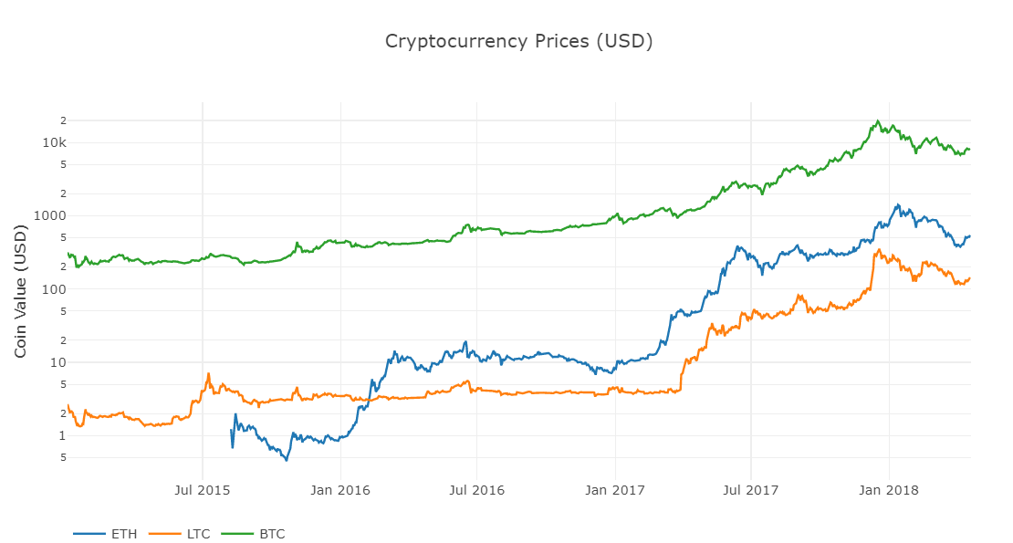
Price Trends:
For the three cryptocurrencies mentioned previously, the price trend from 2014 to 2018 is as seen here:
These prices are fetched from exchanges like COINBASE, KRAKEN, OKCOIN and a few more.
As can be seen, there is a lot of fluctuation in the prices and its reasons are what we are trying to understand.

Slide 5
Data Sources:
For our analysis, we will be scraping and extracting data from Twitter and Kaggle along with following websites.
Below is the list of data sources for each of the three cryptocurrencies:
Bitcoin:
https://news.bitcoin.com
https://www.bloomberg.com
Litecoin:
https://www.litecoinnews.io
Ethereum:
https://www.coindesk.com

Slide 6
Working:
For each of the currencies, we will be scraping news headlines from the sites mentioned along with the date of its publication.
Similarly, tweets regarding the currencies too will be fetched using the Twitter API.
Once the data is scraped and extracted, we will filter out irrelevant data and use VADER to classify the tweets or headlines as positive, negative or neutral.
Once this is done, we will be cleaning and clustering the data using the LDA (Latent Dirichlet Allocation) algorithm.
Finally, we will be predicting the prices using logistic and linear regression.

Slide 7
Process Diagram:
Scrape news headlines and tweets for Bitcoin, Litecoin and Ethereum
Use VADER’s in-built lexicon file to classify the headlines or tweets as positive, negative or neutral.
Cluster the headlines and tweets using LDA (Latent Dirichlet Allocation)
Perform linear/logistic regression on the clustered data to predict the prices
Cleaning and preprocessing of data for clustering purpose
Sources: Twitter, Kaggle, litecoinnews.io, news.bitcoin.com, cryptocurrencynews.com, bloomberg.com

Slide 8
Twitter:
To extract tweets from Twitter, we will be using the Tweepy package.
In the class created for the analysis, we will first be fetching tweets based on the specific keywords like ‘bitcoin’, ‘litecoin’, ‘ethereum’, ‘cryptocurrency’, ‘blockchain’.
Once these tweets are fetched, we will be cleaning them by removing the unnecessary hyperlinks, words and characters using regular expressions.
Finally, the sentiment for each of these tweets will be calculated using the Textblob package in Python and stored in a dictionary.

Slide 9
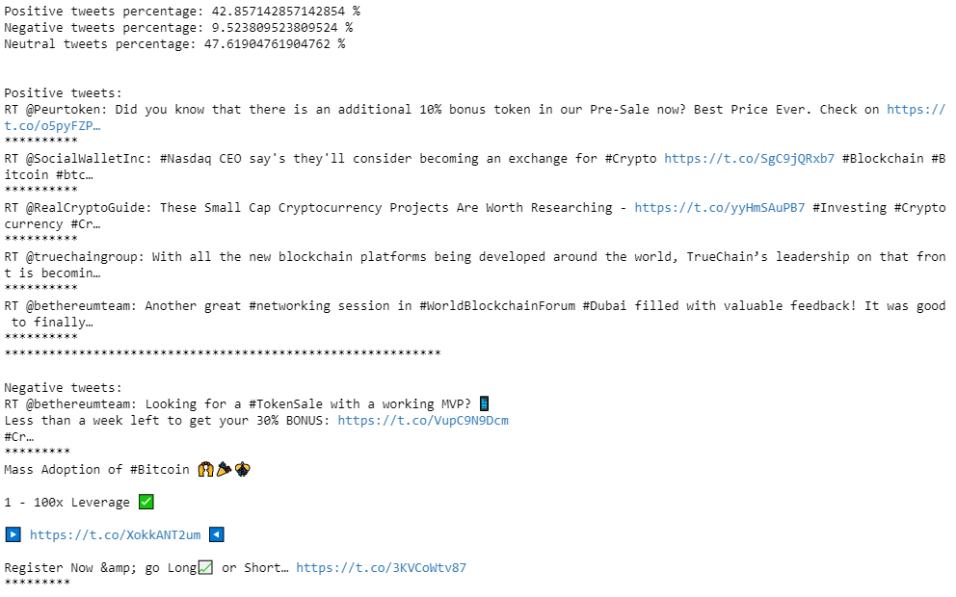
Twitter Sentiment Results:
The screenshots attached herewith show how tweets contribute to price fluctuations in cryptocurrencies.
Positive and negative tweets can be seen.
Also, percentage of the three types of tweets is shown.

Slide 10
Twitter Drawbacks:
The data from twitter is extremely unorganized and unstructured and using it for analysis won’t give us accurate results.
This makes analyzing twitter data very difficult.
Having said that, the results still won’t help investors make profitable investing decisions.

Slide 11
Sentiment Analysis:
Used VADER as our sentiment analyzer using its in-built lexicon file for the analysis.
The analyzer yielded a pretty informative output classifying headlines and tweets into following categories:
Very positive
Somewhat positive
Very negative
Somewhat negative
Neutral
VADER classifies sentiment intensity of sentences from -1 to 1.

Slide 12
Sentiment Analysis Results:
Bitcoin:
1166 neutral headlines
252 somewhat negative headlines
50 very negative headlines
328 somewhat positive headlines
52 very positive headlines
1848 total headlines
Litecoin:
34 neutral headlines
9 somewhat negative headlines
0 very negative headlines
11 somewhat positive headlines
2 very positive headlines
56 total headlines
Ethereum:
235 neutral headlines
46 somewhat negative headlines
7 very negative headlines
71 somewhat positive headlines
10 very positive headlines
369 total headlines

Slide 13
Data Cleaning & Preprocessing:
Tokenized the headlines and tweets.
Removed stop-words.
Removed punctuations.
Performed lemmatization of unique words.
Removed frequent keywords from lemmatized headline tokens to improve clustering performance.

Slide 14
Text Clustering:
Implemented the Latent Dirichlet Allocation (LDA) unsupervised learning algorithm.
Created 5-clustered and 4-clustered documents into topics by word similarity.
Built a prediction model utilizing the cluster breakdown.
Clusters were used as input to predictive regression models
Clustering improved the results of linear and logistic regression model which was insignificant otherwise.

Slide 15
Price Prediction:
There was no significant correlation between the overall daily sentiment and the price movement.
But a specific cluster will have a greater impact on the daily price movements.
Hence, it was necessary to determine specific sentiment scores for the cluster on a given day.
We used days 1 and 3 in our case.

Slide 16
Price prediction using Linear Regression:
Test 1: Linear Regression
In order to predict the exact price value we used linear regression.
Ran 4 multiple linear regression models in total:
5 clusters 1 day price movement
4 clusters 1 day price movement
5 clusters 3 day price movement
4 clusters 3 day price movement

Slide 17
Linear Regression Results:
On analyzing the R-squared values for linear regression performed on Bitcoin for all 4 model types, we found that model 3 worked the best with value 0.063
On analyzing the R-squared values for linear regression performed on Litecoin for all 4 model types, we found that model 1 worked the best with value 0.151
On analyzing the R-squared values for linear regression performed on Ethereum for all 4 model types, we found that model 3 worked the best with value 0.413

Slide 18
Actual vs Predicted Returns(Bitcoin):

Slide 19
Actual vs Predicted Returns(Litecoin):

Slide 20
Actual vs Predicted Returns(Ethereum):

Slide 21
Price prediction using Logistic Regression:
Test 2: Logistic Regression
Instead of predicting exact values we want to predict if the prices will rise or fall.
This is also sometimes useful to investors.
Like investors take a long or short positions in stock market, they can decide to buy or sell the cryptocurrencies in the same manner.
Ran 4 multiple logistic regression models in total (same as before)

Slide 22
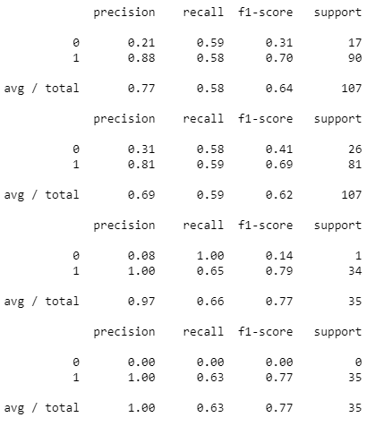
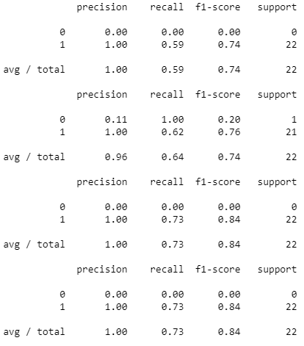
Logistic Regression Results:
On performing logistic regression for Bitcoin and Ethereum, we found out that the model type with 5 clusters and 3 day price movement was still better than other models.
Bitcoin Ethereum
1 day 5 clusters result
1 day 4 clusters result
3 day 5 clusters result
3 day 4 clusters result

Slide 23
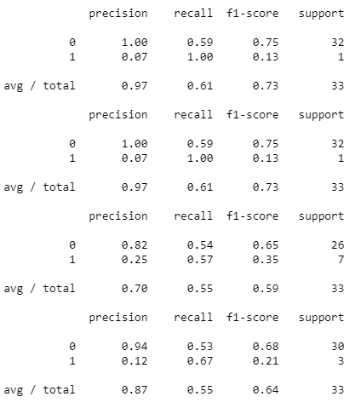
Logistic Regression Results:
For Litecoin, model 1 (1 day 5 clusters) gives better results.
1 day 5 clusters result
1 day 4 clusters result
3 day 5 clusters result
3 day 4 clusters result

Slide 24
Drawbacks:
Some tweets or news headlines are not classified correctly which makes sentiments imperfect.
Clustering too is not really ideal and may need lots of more tweets and headlines to form more diverse groupings.
Predicting something like cryptocurrency trading using simple modeling techniques is a really complex task.

Slide 25
Conclusion:
The tests we ran actually yielded similar results with the five cluster model looking at the price in three days performing the best for Bitcoin and Ethereum.
For Litecoin, the five cluster model looking at the price in 1 day performs the best.
Proves that the price of cryptocurrencies is tied to the news coverage of the currency itself.

Slide 26
Thank you

